Slide 1
NLP Healthcare Stakeholder Broad Classification
The broad classification using their Message/Comment, written on various Blog, Forums, Facebook, Youtube along with other features such as source and Host of Message/Comment etc.

Slide 2
Section - A
Approach Discussion

Slide 3
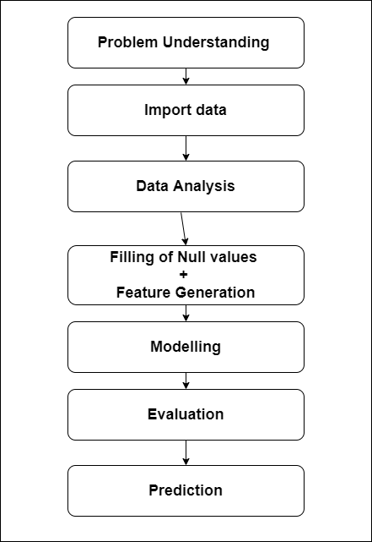
Flow graph/ steps to Approach the Given case study

Slide 4
Problem Understanding

Slide 5
Various Stakeholders of Healthcare are :-
Patients.
Physicians.
Employer under Hospital Management.
Insurance Companies.
Pharmaceutical Firms and govt.
Broadly they are of two types for our consideration.
Patients.
Non-Patient.

Slide 6
Task to Perform
In this case study the task is to classify the stakeholders broadly into 2 categories i.e Patient / Non-Patient using Following Features :-
Content of the message / comment (which Stakeholders have written on various blog and forums etc)
Title of this message / comment.
Source of this message / comment.
Host of this message / comment.
Link of this message / comment.
Date_time in Eastern time(ET).
Date_time in Greenwich Mean time(GMT).
After classification the target variable i.e. ‘Patient_Tag’ is to be predicted using trained classifier.

Slide 7
How the train and test dataset look like.

Slide 8
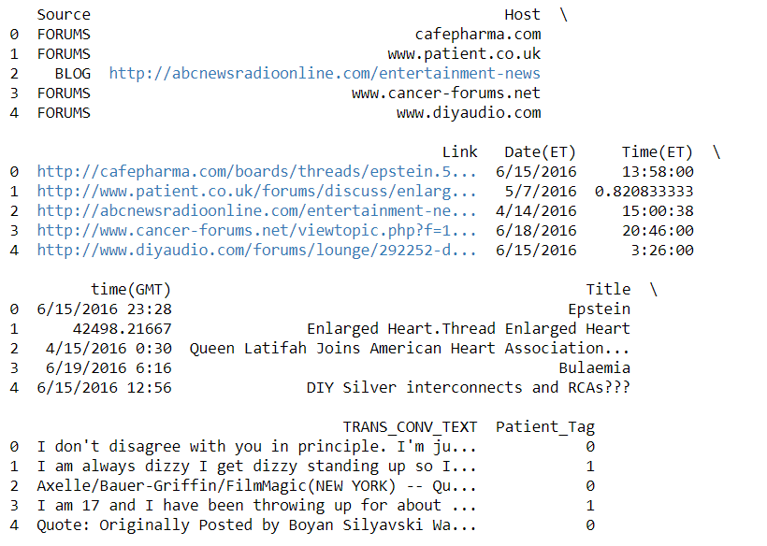
Head of training data

Slide 9
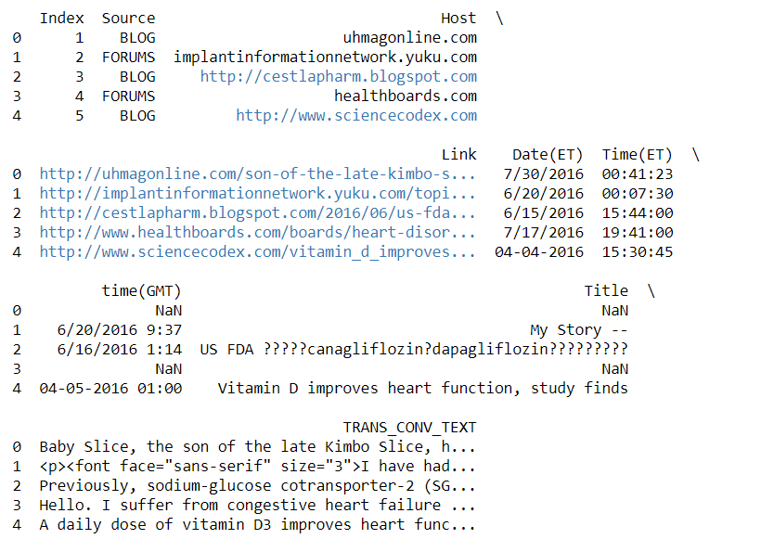
Head of testing data

Slide 10
Trends in Dataset

Slide 11
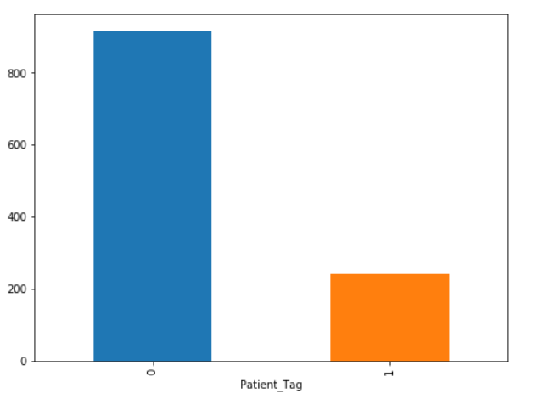
Frequency Distribution of Patient_Tag Column in Train Data
It is clear from this diagram that the data is unevenly distributed for the 2 classes of the target variable i.e Patient_Tag.
To deal with the data which is unevenly distributed the technique of K-Fold Cross-validation is used in this case study.

Slide 12
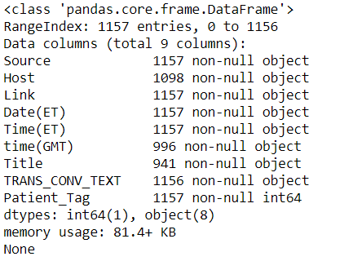
Other information related to training data
It can be seen that the entries in the training data are 1157
Total columns are 9.
Host, time(GMT), Title, TRANS_CON_TEXT columns contain at least 1 null value.
One column have int type data(Patient_Tag) and other 8 column have object type data.

Slide 13
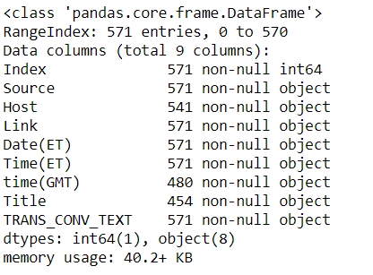
Other information related to testing data
It can be seen that the entries in the testing data are 571
Total columns are 9.
Host, time(GMT), Title columns contain at least 1 null value.
One column have int type data(Index) and other 8 column have object type data.

Slide 14
Various techniques Applied

Slide 15
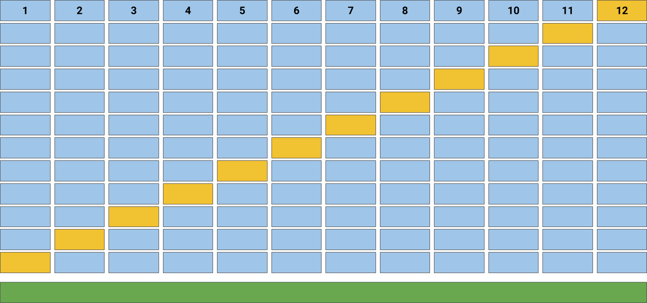
K-Fold Cross-Validation
In this technique the dataset is first shuffled and than it splitted into k parts after this the k models are trained using (K-1) parts of the dataset and and the testing is performed on the k^{th} part but this K^{th} part for testing will be different for K different models. So using this method the models will be less prone to be biased for a particular class of the target function.
The figure is showing 12-Fold Cross-Validation.
In this Project I use 15-Fold Cross-Validation.

Slide 16
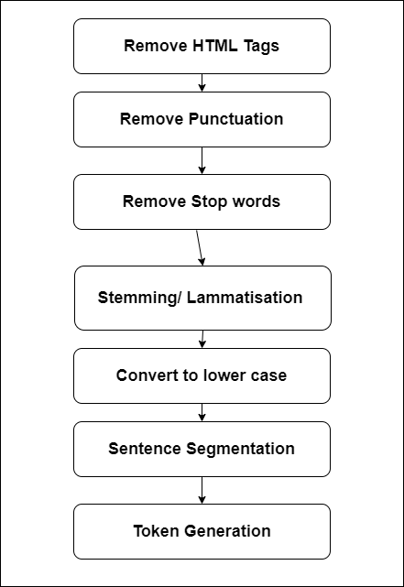
Various steps in Text cleaning process
Firstly, HTML Tags such as <p>, <h1> etc. are removed.
Than, Punctuation marks such as “,”, ”and”, “.” etc. are removed.
Stop words such as this, that and not etc, are removed.
Stemming is performed where similar sentences such as tasteful, tasty are replaced by their root word(Eg. Taste).
Than all the text is converted to the lower case.
After this the whole document is converted into sentences.
And at last the tokens(Single word) are Generated.
In this project I have used TfidfVectorizer() function for the cleaning and than conversion of the text data into the numerical vector/Matrix.

Slide 17
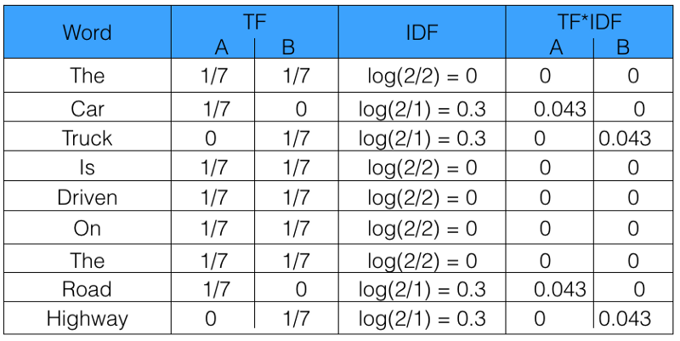
TfidfVectorizer- Method
It uses term frequency and Inverse document frequency to calculate the unique vector from the given document.
Suppose two document/sentence.
A - “The car is driven on the Road”
B - “The truck is driven on the Highway”
Term frequency of each unique term is equal to (# of time the word occur in the document / Total # of words in that document).
Inverse document frequency(IDF) is equal to (total # of document / Total # of document in which that word occur).
IDF in measure of the weight of the term/token in all the documents.
Final Tfidf is calculated by multiplying term frequency and IDF.
So in this example the unique vector for sentence A = [0,0.043,0,0,0,0,0,0.043,0]

Slide 18
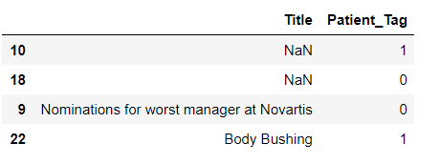
Null value Imputation
For Null value imputation(which are of text format), I have used the ‘Hot deck Imputation’.
In this method the missing values can be filled by the other similar values of that column, here similarity can be defined by any other variable of the data.
Best way to check the similarity is to check for the target variable, the 2 values of a variable will be similar if they have similar value of the target variable.
I have shown 4 instances of the train data in the figure at index number 10,18,9,22.
Null value of the Title variable at index number 10 can be filled with the Value of Title variable at index number 22, because both the instance have value of Target variable value = 1.
Null value of the Title variable at index number 18 can be filled with the Value of Title variable at index number 9, because both the instance have value of Target variable value = 0.

Slide 19
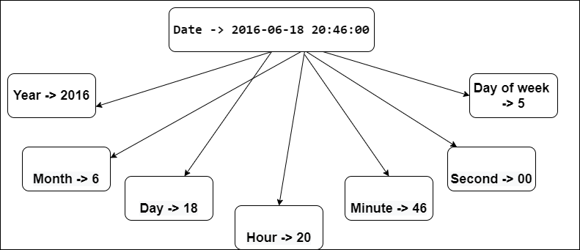
Date time feature extraction
Date time format of the data is precious source of information and it contains the various hidden features inside it which can affect the output significantly.
This is why the date time feature is not to be ignored.
It can be seen from the diagram that the Year, month, Day number of month, day number of week, time in hour, minute and second etc.
There are other features which can be extracted.

Slide 20
Model Selection
Data for training is not that much sufficient so that Deep learning models such as CNN or LSTM can be trained(these are more suitable for the sequence/ Text data).
The deep learning models at least requires 1000 instances of each class, but in our case the training data set only have approximately 240 values for (Patient_Tag = 1) class and 916 instances for (Patient_Tag = 0) class.
So we can train the Machine learning models.
First, I choose Naive bayes algorithm which does not require much training data, so it is the suitable machine learning model to apply here.
Than, I select Support Vector classifier which also does not need more training data, it do require more computation power than Naive bayes but it gives better results.
Random forest is another machine learning model which works on multiple decision tree and it is better algorithm in case of classification of text data containing some noise.
Logistic regression is an useful classification technique when the dataset have only 2 classes(In our case the classes are 2).
With this much data the simple neural network/Multilayer Perceptron can perform well.
The models can be selected through some prior intuition but their performance can vary from one dataset to another dataset of same type.

Slide 21
Section - B
Source code Explanation

Slide 22
Import Libraries and dataset

Slide 23
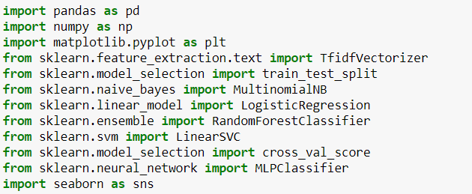
Libraries Used
Pandas library is for the data manipulation and Analysis.
Numpy is the library which can be used to work on the array and matrices.
Matplotlib.pyplot and Seaborn are the data visualization libraries which are used here.
Line number 5 in the code is for the splitting of the data.
Line number 6,7,8,9,11 are for importing various models which are used here.
Line number 10 in the code cell is for performing importing library which will help in performing the K-Fold Cross-validation.
Line number 4 of the code cell is for importing library which will help in converting the text feature into its corresponding numerical matrix for term frequency.
-
-
-
-
-
-
-
-
-
-
-
-

Slide 24
Importing train dataset
The training dataset is imported using pandas and stored as pandas dataframe.
Unicode_escape encoding method is used here for the purpose of encoding while the data read perform on the training data to store into the dataframe.

Slide 25
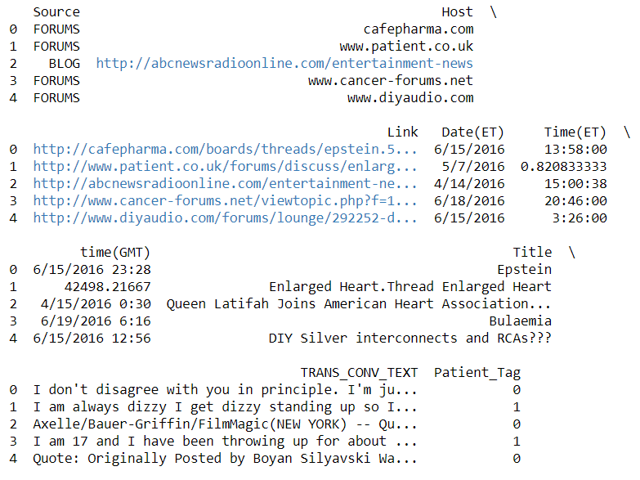
Showing the head of training data(Output Cell)
This is the head of the training data which contains 9 features.
Most significant features in the dataset are ‘TRANS_CONV_TEXT’ and ‘Title’ because they will be telling more about the type of Stakeholder of the healthcare, it is obvious by domain knowledge.

Slide 26
Data Analysis

Slide 27

Frequency distribution of Target function
In first line of the cell the size of image is defined i.e (8,6).
Than the plotting of the frequency distribution of the target variable for the train dataset is performed.

Slide 28
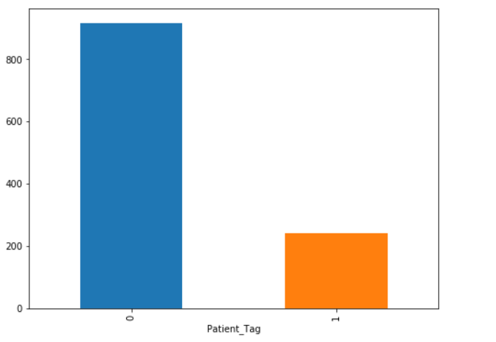
Bar graph for the Patient_tag column(Output Cell)
Here it is clear that the data is unevenly distributed.
(Patient_Tag = 0 ) class have more instances than (Patient_Tag = 1 )

Slide 29

Analyzing the test data
In this first line of the cell all the column names are printed.
In the second line, the number of null values in each columns of the dataframe are checked.
Third line of the cell will tell all the information related to the data frame including the null values and memory storage requirement by it.

Slide 30
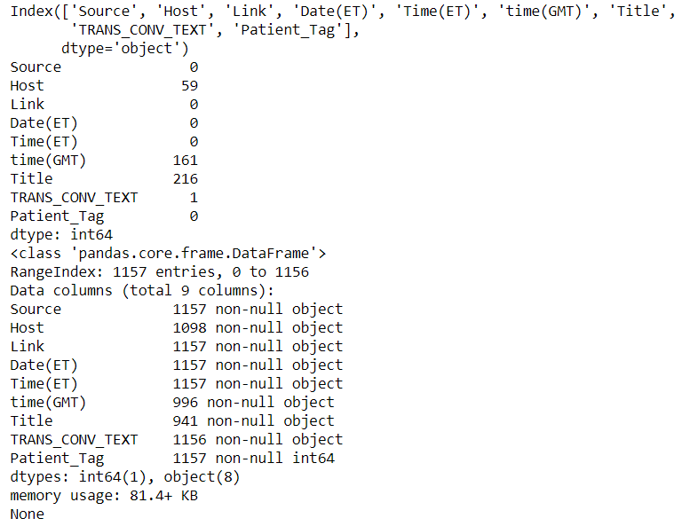
Information related to train data is printed(Output Cell)
All the columns, the number of null values in these columns are printed.
Other information related to the data frame storing the train data is printed.

Slide 31
Feature Generation and
Null value Imputation

Slide 32
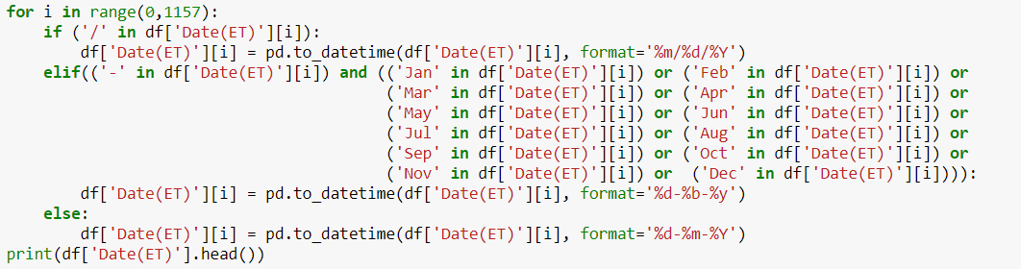
Converting ‘Date(ET)’ Column into date_time format
The Values present in the Date(ET) column are in 3 formats.
These format are -- 6/15/2016, 17-Jun-16 and 05-07-2016.
In First part of the for loop, I am updating the dates which are of string type in format '%m/%d/%Y'.
In Second part of the for loop, I am updating the dates which are of string type in format '%d-%b-%y'.
In Third part of the for loop, I am updating the dates which are of string type in format '%d-%m-%Y'.
After this I am printing the head of this column.

Slide 33
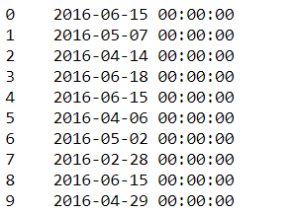
How updated Date(ET) column will look like(Output Cell)
As this column was initially containing the Date not the time so it added the default value of the time.
Default value of time ‘00:00:00’ added along with the date.

Slide 34
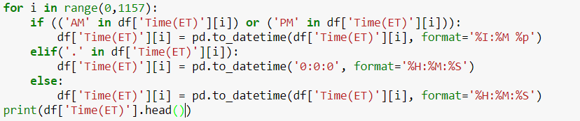
Converting ‘Time(ET)’ Column into date_time format
The values present in the Time(ET) column are in 3 formats.
These format are -- 12:34 AM, 0.445902778 and 23:56:00.
In First part of the for loop, I am updating the dates which are of string type in format '%I:%M %p'.
In Second part of the for loop, the time is a random error, so I am updating them with ‘00:00:00’.
In Third part of the for loop, I am updating the dates which are of string type in format '%H:%M:%S'.
After this I am printing the head of this column.

Slide 35
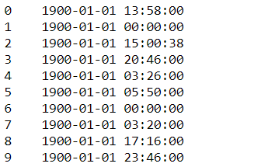
How updated Time(ET) column will look like(Output Cell)
As this column was initially containing the Time not the dates so it added the default value of the date.
Default value of date is ‘1900-01-01’ added along with the time.

Slide 36
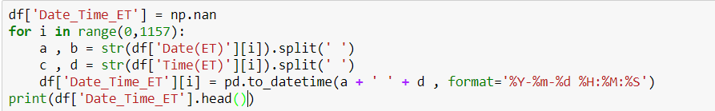
Combine Date(ET) and Time(ET) column to get date_time in ET
In first line the column with null values initialize.
And then the first part of ‘Date(ET)’ is combined with the second part of the ‘Time(ET)’ which contains the date and time respectively in them.
After this the ‘Date_Time_ET’ will contain the date and time in the Eastern format.

Slide 37
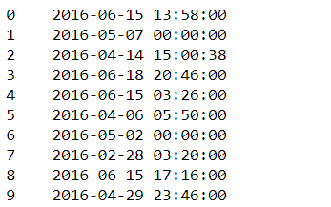
How updated Date_Time_ET column will look like(Output Cell)
It can be seen that the date and time in Estern Time format are stored in one column.

Slide 38
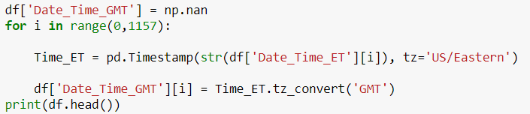
Generating Date_time in GMT format
In first line of the cell a new column named ‘Date_Time_GMT’ generated with null values.
Since the time(GMT) column have the null values, so it will be better if the date_time of GMT format are generated using the date_time in ET format which doesn’t have any null values.
In last line the head of data frame is printed to have a look of data frame.

Slide 39
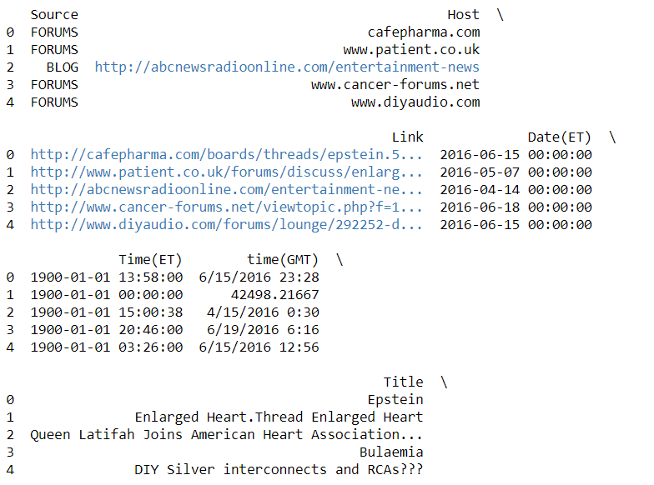
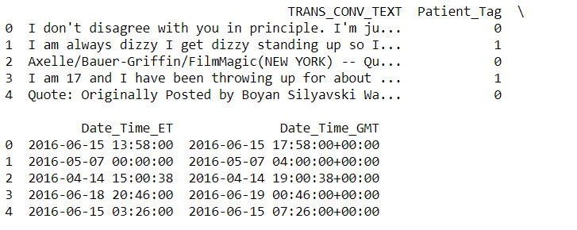
How updated data frame will look like after adding data time in GMT format(Output Cell)
It can be seen that Date time in GMT format is added in the data frame and it is 4 hours ahead of ET time.

Slide 40
Dropping the ['Date(ET)', 'Time(ET)', 'time(GMT)'] columns
In the first line the 3 columns named ‘Date(ET)’, ‘Time(ET)’ and ‘time(GMT)’ are dropped.
In second line the head of the ‘df’ data frame is printed.

Slide 41
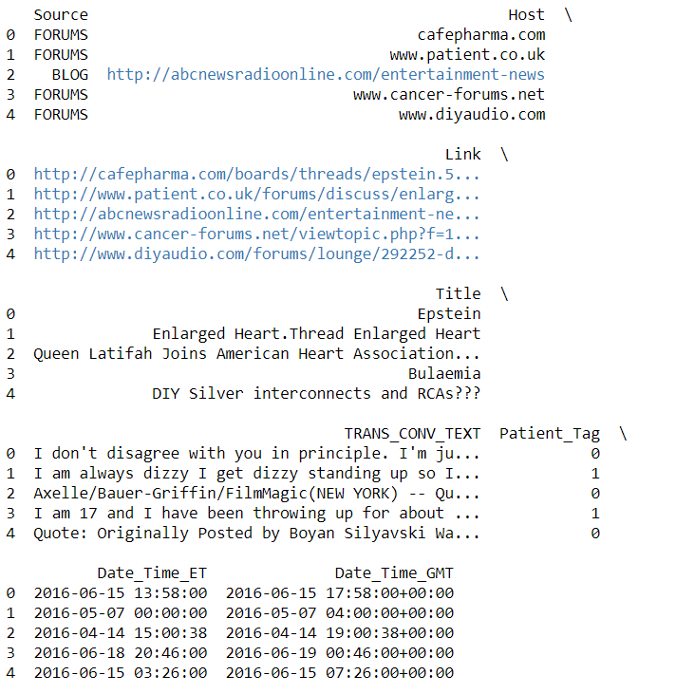
How updated data frame will look like after dropping some columns(Output Cell)
It can be seen that now the data frame have the two columns for date time one have date time in ET and other have in GMT Format.
It is also noted that the date and time in GMT are 4 hours ahead of the ET, it is because the GMT format here used is GMT-4 which is 4 hours ahead of the ET.

Slide 42
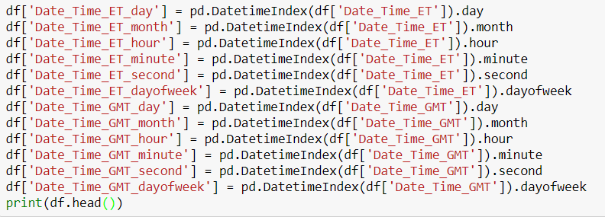
Generating the various date time features
Here various features are extracted from two formats of the data and time.
Various feature are :- ‘day’, ‘month’, ‘hour’, ‘minute’, ‘second’, ‘day_of_week’.
I have not use the year as a feature and the reason for that is that the year is constant (all the rows in train as well as test have year of 2016), so the target variable is not dependent of the year.
In the last line of the cell the data frame is printed to have a look at it.

Slide 43
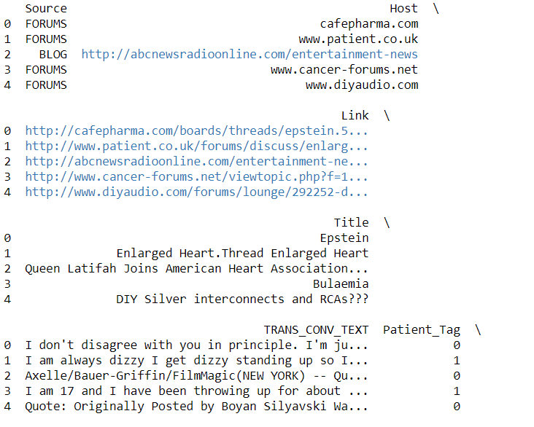
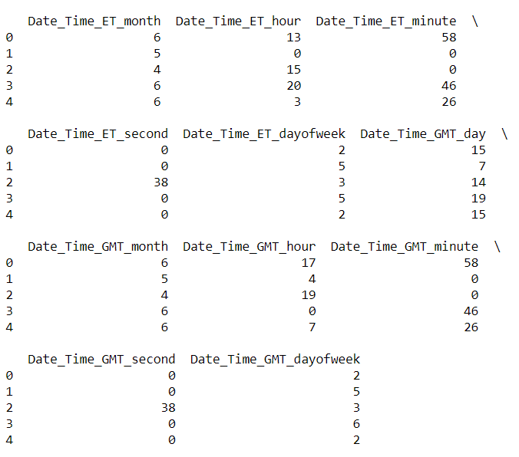
How updated data frame will look like after adding date time features(Output Cell)
It can be seen that now the data frame have some new features containing the number of day in the month, number of month, hour, minute, second, number of day in week in ET and GMT format.
All these columns have type of int which indicated that these columns doesn’t need any further updation.

Slide 44
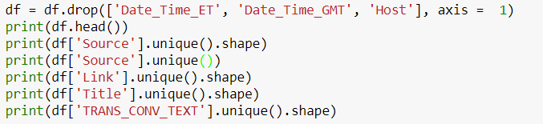
Dropping some columns and checking unique values of some features.
Here in the first line of the cell the feature ‘Date_Time_ET’, ‘Date_Time_GMT’ and ‘host’ are dropped.
It is because first two features are of no use as the feature extraction from the date time feature is already done.
Third feature i.e. ‘Host’ is dropped because the Host feature contains the text date which is subset of the corresponding values of the ‘Link’ feature so it does not add any new information in the data.
Than the head of the data frame is printed and after that the unique values of the feature ‘Source’, ‘Link’, ‘Title’, ‘TRANS_CONV_TEXT’ are printed.

Slide 45
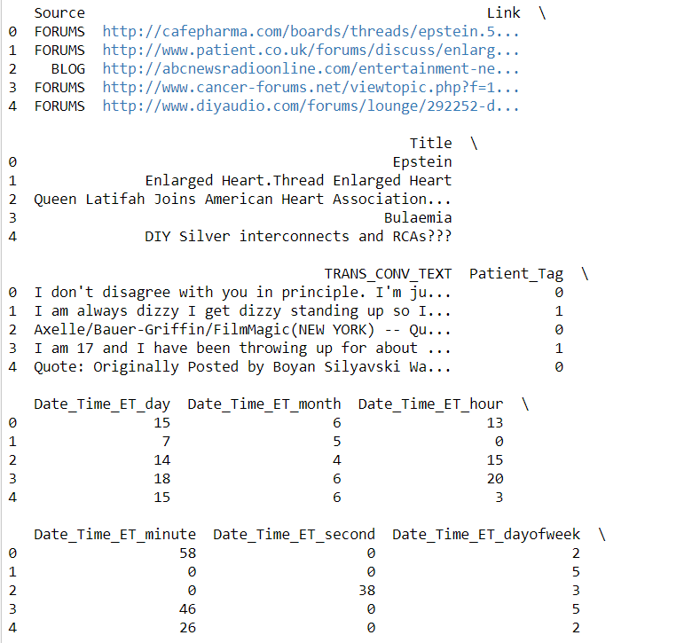
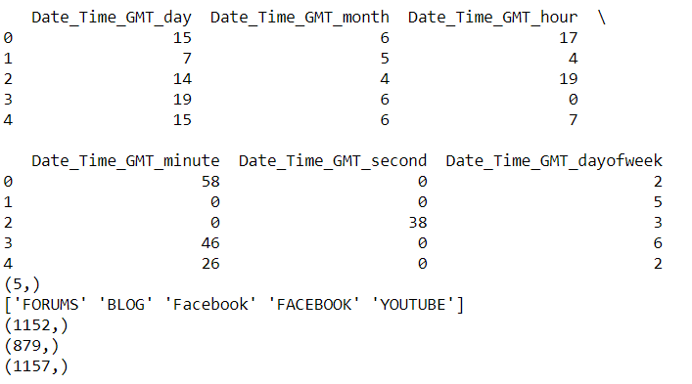
How updated data frame will look like after adding date time features(Output Cell)
It can be seen that now the data frame have not the previously dropped columns/features.
It can also be observed that only ‘Source’ column have the finite unique values which can be replaced by some numerical categories.
‘Source’ have 5 unique values.
But unique values such as ‘Facebook’ and ‘Facebook’ need to considered as one unique value.
Other features have not finite unique values in compare to the size of the dataset.
‘Link’ column have 1152 unique values.
‘Title’ column gave 879 unique values.
And ‘TRANS_CONV_TEXT’ column have 1157 unique values.

Slide 46
Replacing categorical values of the Source feature with numerical values.
Since there are 5 types of values(‘FORUM’, ‘BLOG’, ‘YOUTUBE’, ‘Facebook’, and ‘’FACEBOOK) inside the ‘Source’ column.
But both value of facebook are treated as one.
So they are replaced by 0,1,2,3,3 respectively.
In last line of the head the head of the source column is printed.

Slide 47
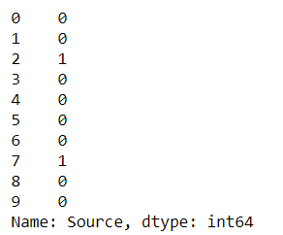
How updated Source column look like(Output Cell)
It can be seen from output cell that the now Source column have only categorical numerical values.

Slide 48
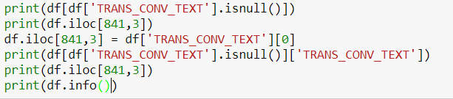
Null value filling in TRANS_CONV_TEXT column
In first line it is checked that which rows of the ‘TRANS_CONV_TEXT’ column have null values.
There is only one row of this column is having null value.
It is present at index number 841.
Here I filled this null value with value of ‘TRANS_CONV_TEXT’ of that row which have same ‘Patient_Tag’ value as it is for the row which contains the null value.
So I manually choose index number 0 and use its ‘TRANS_CONV_TEXT’ feature value to fill the null value.
In further lines of the cell the information of the data frame is printed.

Slide 49
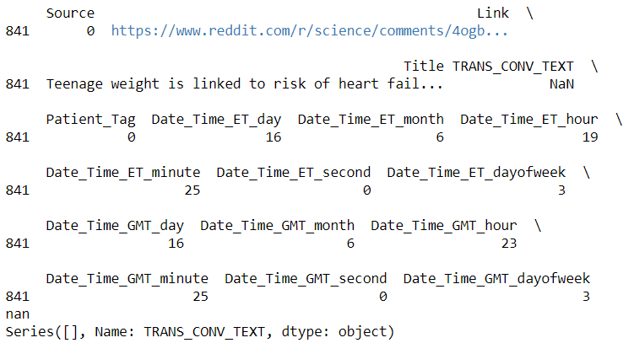
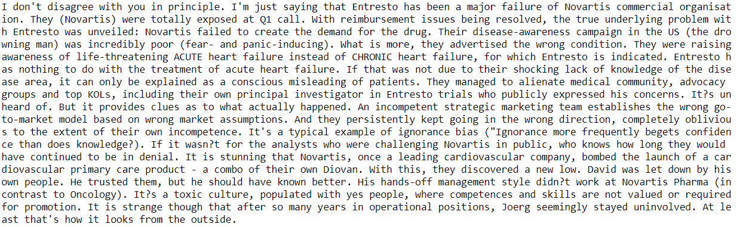
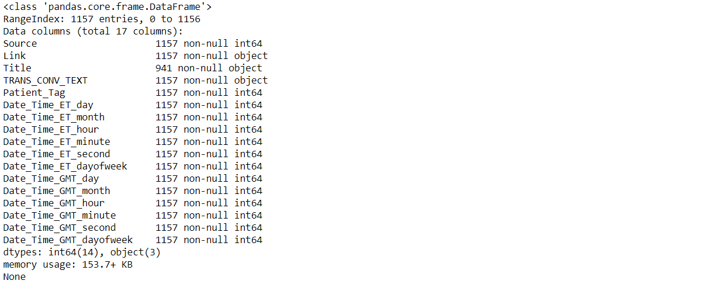
How updated data frame will look like after adding date time features(Output Cell)
In output first the row number 841 is printed and it is clearly seen to have the null value in the ‘TRANS_CONV_TEXT’.
Than I have printed the value of ‘TRANS_CONV_TEXT’ at 0 index which have same ‘Patient_Tag’ value as it is for index number 841.
At last I have printed the information of the data frame and it can be clearly seen that now only ‘Title’ column have null values.
And all the columns are either in “int” or “Object” format.

Slide 50
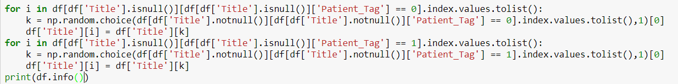
Null value filling of the Title column
For filling the null values of the Title column I have used the same logic which I used in the filling of the null values of the ‘TRANS_CONV_TEXT’ column.
Null values of the Title column are filled by the values of the Title column of that row which have same value for the ‘Patient_Tag’ as it is for the row which contains the null value.
But as the number of null values in Title column are not few so we use random function to choose the value to fill.
In last line of the cell I printed the information of the data frame to check if there is any null value in it or not.

Slide 51
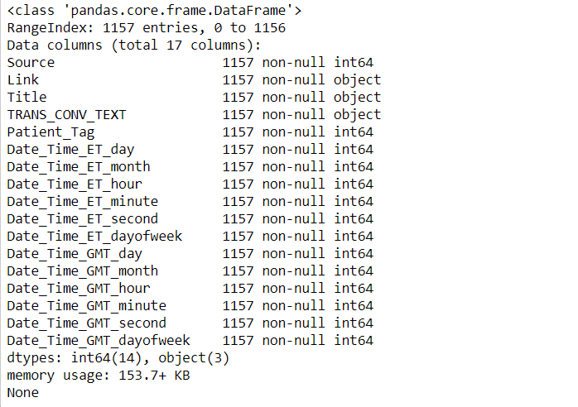
Checking the information of the data frame after filling all the null values(Output Cell)
It can be seen from output cell that there is no null value in the whole dataframe for the train data.
But there are 3 columns which have “Object” type which contains the strings.
These 3 columns are ‘Link’, ‘Title’ and ‘TRANS_CONV_TEXT’.

Slide 52
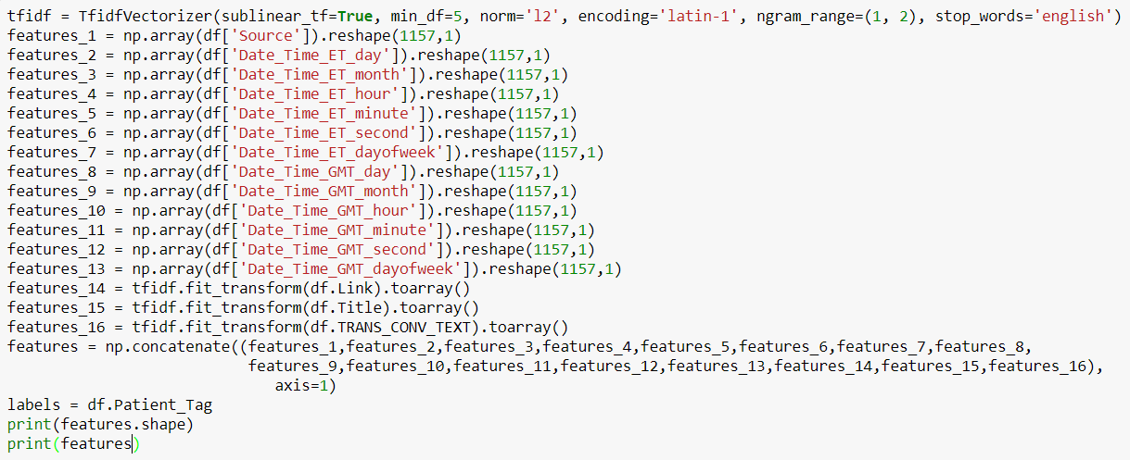
Building the final feature matrix and label vector
I use TfidfVectorizer() function to process the text data and convert into structured data which can be processed.
So feature_14, feature_15, feature_16 are the 3 matrices which are made by processing the 3 Text features i.e. ‘Link’, ‘Title’ and ‘TRANS_CONV_TEXT’.
These are the ndarray.
So we need to have other features in the nd array format.
I have concatenate all these features matrices to get the feature matrix.
One matrix is created for the target variable, I named it as label matrix.

Slide 53
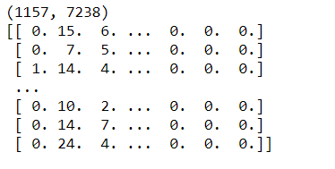
Feature matrix and its size(Output Cell)
First line of the output cell contains the size of the feature matrix created which is (1157,7238).
Print the feature matrix to have a look at it.

Slide 54
Modelling and Evaluation

Slide 55
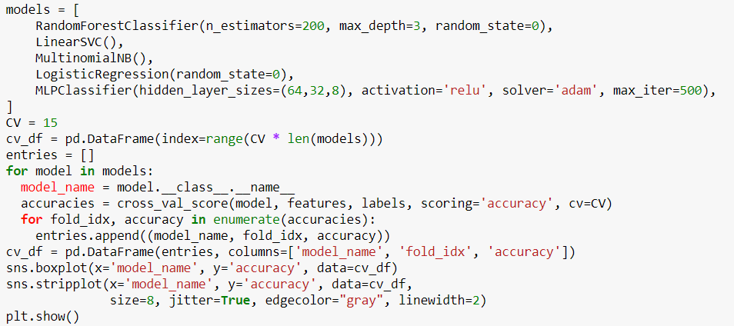
Modelling
Here in first line of the code cell, I have made a list of 5 models which I have applied.
The 5 Models are Random Forest, Linear Support Vector Classifier, Multinomial Naive Bayes, Logistic Regression, Multi Layer Perceptron which is a Neural network Model.
Since I have used 15-Fold cross-validation so I have defined cv = 15.
After this one by one 15 fold cross-validation run over 5 models and the variable cv_df will contain the accuracies of all the 15*5 = 45 models.
Now visualization of the accuracies for each model is plotted by using seaborn library in the form of box plot.

Slide 56
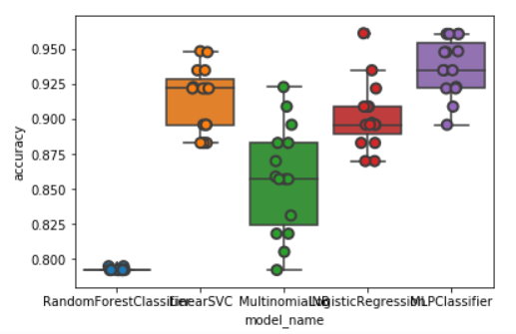
Box Plot of Accuracies for Each classifier / Model
Here is the Box Plot of the various models type.

Slide 57
Printing the Mean accuracies of the all the Classifiers
Printing the mean accuracy for all the models / classifiers.

Slide 58
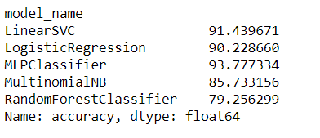
Output showing the Mean accuracies of all the classifiers(Output Cell)
Mean accuracy of all the models can be seen in the output cell.
Mean accuracy of Multi layer perceptron model is highest which comes out to be 93.77 %

Slide 59
Prediction

Slide 60
Import the test data
Test data is imported on which the prediction is to be performed.

Slide 61
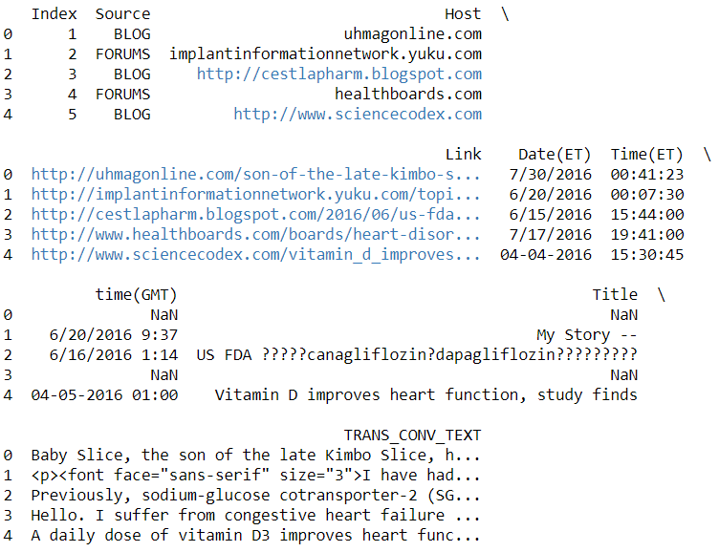
Output cell showing the look of the test data frame(Output Cell)
Here it is clear from the output cell that it has all the feature and Target feature which is not in test data is to be predicted.

Slide 62

Checking for the Null values in the test data set
Here in the cell the null values in each column of the test data are checked.

Slide 63
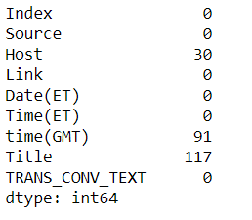
Null value checking(Output Cell)
It can be seen that ‘Host’, ‘time(GMT)’ and ‘Title’ contains the null values.

Slide 64
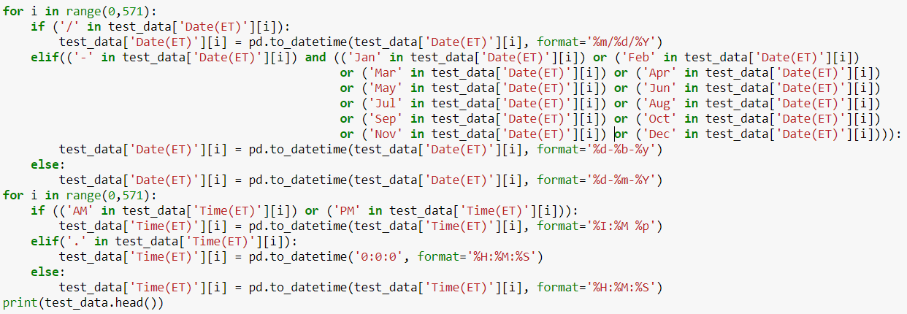
Converting ‘Date(ET)’ and ‘Time(ET)’ Column into date_time format
Similar to the train data test, test data also contains the dates and time in 3 string format.
And they are converted into datetime format in the similar way as it is in case of train data.

Slide 65
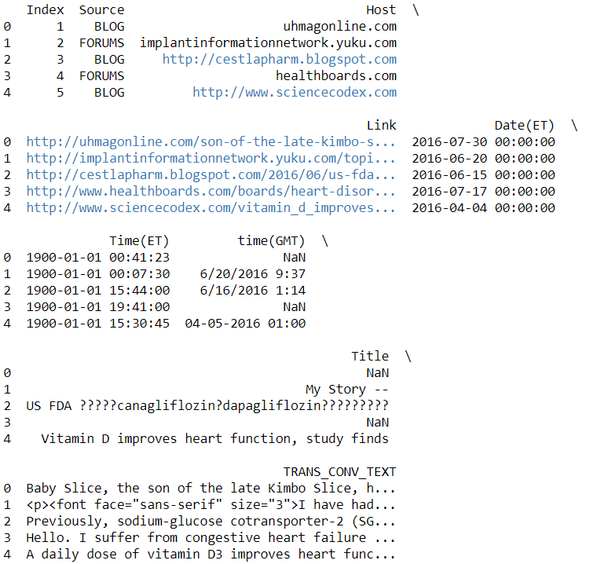
Printing head of the test data frame after date and time converted into date time format(Output Cell)
Similar to train data Date(ET) and Time(ET) column will contains the default value of time and date respectively.

Slide 66
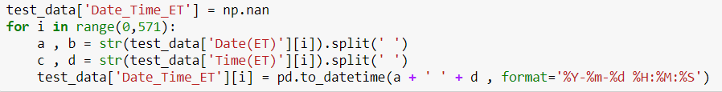
Combine Date(ET) and Time(ET) column to get date_time in ET
In first line the column with null values initialize.
And then the first part of ‘Date(ET)’ is combined with the second part of the ‘Time(ET)’ which contains the date and time respectively in them.
After this the ‘Date_Time_ET’ will contain the date and time in the Eastern format.

Slide 67
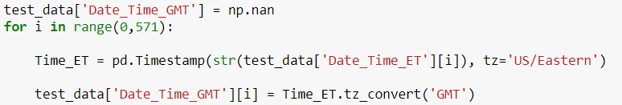
Generating Date_time in GMT format
In first line of the cell a new column named ‘Date_Time_GMT’ generated with null values.
Since the time(GMT) column have the null values, so it will be better if the date_time of GMT format are generated using the date_time in ET format which doesn’t have any null values.
In last line the head of data frame is printed to have a look of data frame.

Slide 68
Dropping the ['Date(ET)', 'Time(ET)', 'time(GMT)'] columns
In the first line the 3 columns named ‘Date(ET)’, ‘Time(ET)’ and ‘time(GMT)’ are dropped.
In second line the head of the ‘df’ data frame is printed.

Slide 69
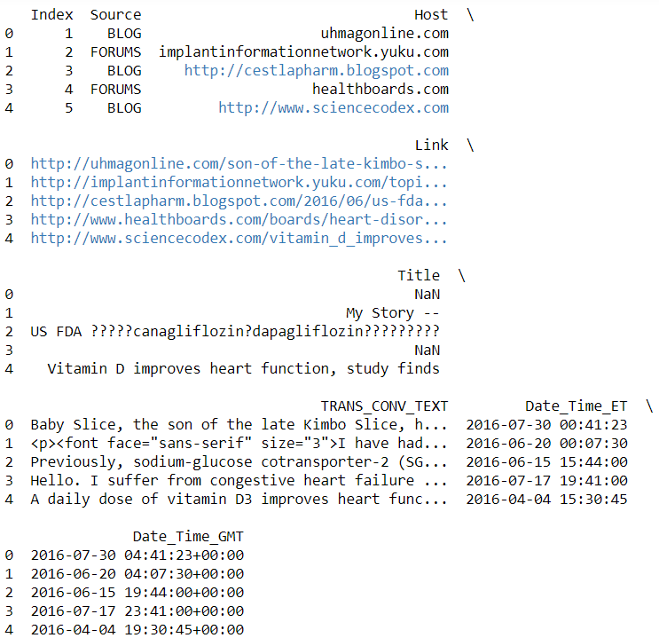
Printing data frame after processing the date time column(Output Cell)
It can be seen that now the data frame have the two columns for date time one have date time in ET and other have in GMT Format.
It is also noted that the date and time in GMT are 4 hours ahead of the ET, it is because the GMT format here used is GMT-4 which is 4 hours ahead of the ET.

Slide 70

Generating the various date time features
Here various features are extracted from two formats of the data and time.
Various feature are :- ‘day’, ‘month’, ‘hour’, ‘minute’, ‘second’, ‘day_of_week’.
I have not use the year as a feature and the reason for that is that the year is constant (all the rows in train as well as test have year of 2016), so the target variable is not dependent of the year.
In the last line of the cell the test data frame is printed to have a look at it.

Slide 71
Dropping the ['Date_Time_ET', 'Date_Time_GMT'] columns
Here in the first line of the cell the feature ‘Date_Time_ET’, ‘Date_Time_GMT’ and ‘host’ are dropped.
It is because first two features are of no use as the feature extraction from the date time feature is already done.
Third feature i.e. ‘Host’ is dropped because the Host feature contains the text date which is subset of the corresponding values of the ‘Link’ feature so it does not add any new information in the data.
Than the head of data frame is printed.

Slide 72


Printing the head after dropping some columns(Output Cell)
So the columns ‘Date_Time_ET’, ‘Date_Time_GMT’ and ‘Host’ are dropped from the data frame.

Slide 73
Replacing categorical values of the Source feature with numerical values.
Since there are 5 types of values(‘FORUM’, ‘BLOG’, ‘YOUTUBE’, ‘Facebook’, and ‘’FACEBOOK) inside the ‘Source’ column.
But both value of facebook are treated as one.
So they are replaced by 0,1,2,3,3 respectively.
In last line of the cell the information of the test data frame is printed.

Slide 74

Showing total null values in the test data frame(Output Cell)
It can be seen that neither of the column have null values except Title.

Slide 75
Filling all the values of Title with string ‘0’
For test data we don’t have target feature so I can not fill null values of the Title feature using the same method which I have used in filling null value of the train data.
Their are other methods to fill null values of text type such as hot deck imputation but I am using string ‘0’ to impute the various null values of the Title in the test data, it is because we don’t have target function for that.

Slide 76

Building final feature matrix and label vector for the test data frame
I use TfidfVectorizer() function to process the text data and convert into structured data which can be processed.
So feature_14_for_test, feature_15_for_test, feature_16_for_test are the 3 matrices which are made by processing the 3 Text features i.e. ‘Link’, ‘Title’ and ‘TRANS_CONV_TEXT’.
These are the ndarray.
So we need to have other features in the nd array format.
I have concatenate all these features matrices to get the feature matrix.
One matrix is created for the target variable, I named it as label matrix.

Slide 77

Final feature matrix and its shape for the test data(Output Cell)
As it is clear that the column of the feature matrix for train data i.e. , is different from the column of feature matrix of the test data i.e.
With this inequality of number of columns, feature matrix of test data can not predict target vector with the help of the classifier which trained on feature matrix with different size.
So some columns of 0 values can be added to make columns of feature matrix for test data same as columns of feature matrix for the train data.
It does not affect the output as adding a column with all the values of same class or same values will not affect performance but only increase some sort of computation.

Slide 78

Adding some extra columns in feature matrix of test data
Some extra columns added with all the values ‘0’.
The number of these extra column equals to the difference in the number of columns in feature matrix of train and feature matrix of test data.
In last line I am printing the shape of the feature matrix of the test data.

Slide 79
Shape of the feature matrix of the test data(Output Cell)
Shape of feature matrix for test data comes out to be same as shape of the feature matrix of train data.

Slide 80
Building a classifier and predict the target variable
As the Multi layer perceptron gives the best accuracy so that is why I have select it to make prediction of the target variable.
In second line of the cell prediction is made.
In last line first 6 predicted values are printed.

Slide 81

Printing Some predicted values of the target variable(Output Cell)
So first 6 value predicted are all 0’s.
So classifier classify first 6 instance of the test data to be Non-Patient.

Slide 82

Making pandas dataframe from nd_array of predicted values
Here a data frame is made by using submission nd array as 2nd column and first column contains the indexing from 1,2,....571.
In last line first 6 rows of this data frame are predicted.

Slide 83

Printing data frame containing the predicted values of the target variable(Output Cell)
It has 2 columns first for index start from 1 and other column is for predicted value of the target function.

Slide 84

For exporting the data frame into csv
In first line the directory is changed to the directory where I want this csv file.
In second line the csv is exported to the desktop in my system.
These predicted values of the target variable may have some amount of error because of the null value imputation by ‘0’ string in case of test data.

Slide 85
Thank you.
Any question?

